Slide 1
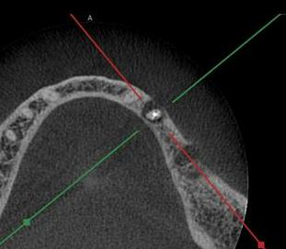
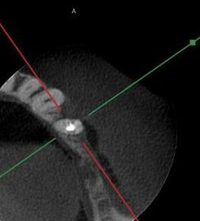
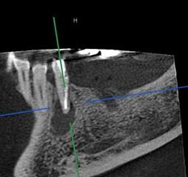
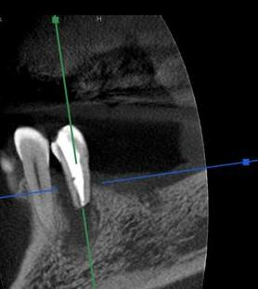
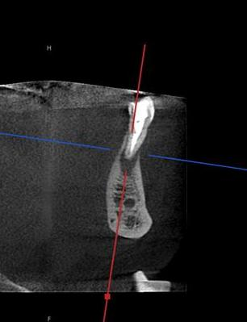
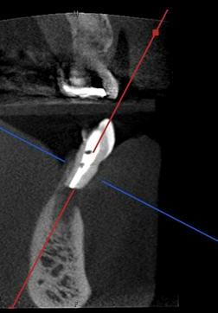
Sagittal
Ａｘｉａｌ
3 Months Post-op
Pre-op
Pre-op
Ｙｏｓｈｉｋａｗａ Ｄｅｎｔａｌ Ｃｌｉｎｉｃ
Coronal
3 Months Post-op
Pre-op
3 Months Post-op

